Slide 1
Limits and Co-Limits
Chapter 12

Slide 2
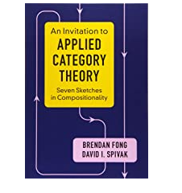
Cones and Limits
Fong and Spivak:
“The main point is that it is possible to unify terminal objects, maximal elements, and meets, products of sets, preorders, and categories, and many other familiar friends under the scope of a single definition. In fact, they’re all just terminal objects in different categories.”

Slide 3
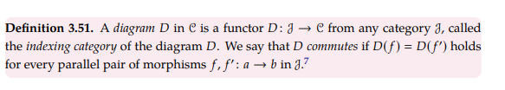
Fong and Spivak:

Slide 4
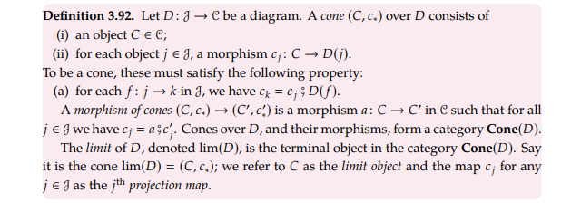
Fong and Spivak:

Slide 5
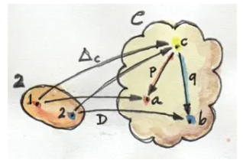
Motivation for Cone and Limit
Think of Product for arbitrary category C, which has objects {a, b, c}.
Functor, D, from the category 2 to C, s.t. D(1) = a and D(2) = b.
Functor Delta that collapses all objects of 2 to one element, c, in C.
Natural transformations between D and Delta? If naturality is satisfied we have that c is a Product of a and b in C. This depends on the exact nature of C.
p and q are components of natural transformation

Slide 6
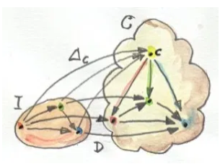
Cone
In general, we can change our source category. Doesn’t always have to be 2, like in previous slide. Depending on what we’re interested in we could choose other categories that have non-trivial morphisms.
If we impose the naturality condition on the two functors, D and Delta, we will get a transformation called a cone.
The image of Delta is the apex of the cone.
The image of D forms the base.
Source category has 3 objects, not 2, here!

Slide 7
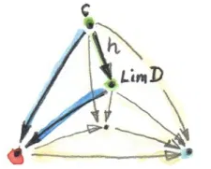
Universal Cone
It’s possible to have many cones (i.e. different apexes) depending on how we define Delta (our constant functor) – we want a universal cone for a given base.
Define Category of Cones, where each object is a cone based on the given functor D.
Morphisms in this Category of Cones are morphisms between apexes.
We impose the extra condition that the triangles that have one side as the factorising morphism all commute (like Product).
h is factorizing morphism
Recall “Commute: Any directed path with same start and end points leads to the same result.”

Slide 8
Universal Cone (cont.)
The Universal Cone is the Terminal Object in the category of Cones.
Recall TO: “the object with one and only one morphism coming to it from any object in the category.”
This implies there is a unique morphism from any other cone to the apex of the universal cone.
The Universal Cone is called the Limit of the diagram D.
We also call the apex of this cone the Limit.
The limit embodies the properties of the whole diagram (this the image of the functor D) in a single object.
For example, the limit of the two object diagram is the Product.

Slide 9
Limit as a Natural Isomorphism
Comparing cones with the commutativity condition is somewhat messy. Commutativity itself suggests some sort of natural transformation.
Motivation: Given any cone there is a unique morphism of a special kind (this is what the Limit gives if it exists) to LimD.
Want to pick for each c (object in Category C) one morphism from the set C(c, LimD) that satisfies the particular commutativity condition, (with LimD as the apex of the universal cone).

Slide 10
Limit as a Natural Isomorphism (cont.)
Turns out this is the same as defining a Natural Transformation between two functors: the mapping of the object c to the set C(c, LimD) and the mapping of c to Nat(Delta, D).
A functor D from I to C has a limit LimD if and only if there is a natural isomorphism between the functors above.
(Recall: a Natural Isomorphism is a Natural Transformation whose every component is an isomorphism).
The naturality condition for the isomorphism is exactly the commutativity condition for the mapping of the cones.

Slide 11
Examples of Limits
Product (limit generated by simple category called 2)
Terminal object (limit generated by empty category). Here, the functors Delta and D will map to just a single point in C. Thus the universal cone is just the cone/point that has a unique morphism from every cone/point to itself, which is the terminal object.

Slide 12
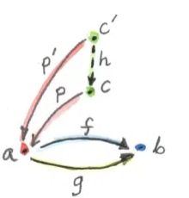
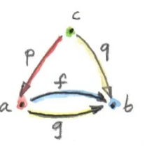
Examples of Limits (cont.)
Equaliser (limit generated by two element category with parallel morphisms going between them).
Naturality between functors gives f.p = q.p
Consider a = R^2, b= R and f(x,y) = 2*y + x and g(x,y) = y-x.
Then f = g iff 2*y + x = y – x iff y = -2x iff (x,y) =(t, -2 t)
Thus, c is then R and p(t) = (t, (-2) * t). This defines a straight-line in the plane.
Could also have c’ = () (singleton). And p’() =(0,0).
Or c’ = {1, 2} with p’ = (t,-2t), but these can all be uniquely factored out. For the first, h()= 0 and for the second h(x) = x;

Slide 13
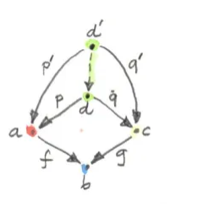
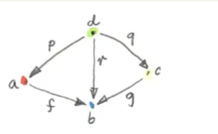
Examples of Limits (cont.)
Pullback (limit generated by three object category).
We can think of d as consisting of pairs of elements from a to c for which f acting on the first component is equal to g acting on the second component.
r can be ignored as
f o p = g o q = r and so is completely determined.

Slide 14
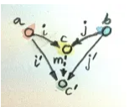
Co-Limit
Limits have dual image in opposite categories.
Invert directions in arrows of a cone, you get a co-cone.
Universal co-cone is called a co-limit and this is the Initial Object in the Category of Cones.

Slide 15
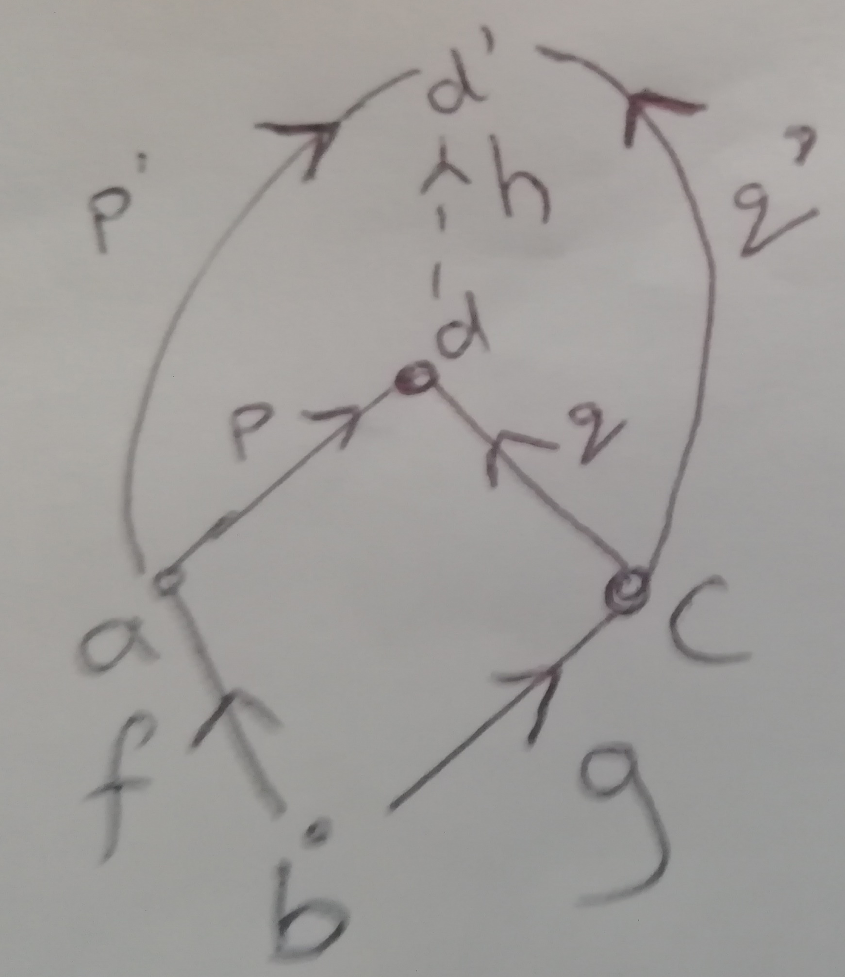
Exercises – Q1
We are already told that in C++ we can consider morphisms as arrows that connect subclasses to superclasses.
In this case a pushout, d, is the class that classes a, b, c all inherit from.
However, it also means that any class d’ that both a and c inherit from d also inherits from. You can think of d as having the most amount of functionality that types a and c both need.

Slide 16
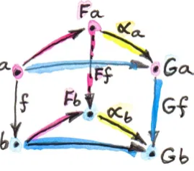
Exercises – Q2
Here the initial category is C as well as the target category. The functor Delta still collapses all the objects onto some point c. Now, though, functor D has been replaced by the Identity functor.
For every cone, the apex c has a morphism going to every object in the category.
Thus, the limit cone (which is just a cone) has a morphism, call it p_x, going to every other object in the category.
But are the morphisms unique?
Wish to show that if there is a morphism from object c to x, say f, then it must be equal to p_x.
Naturality gives Gf o alpha_c = alpha_x o Ff.
Let G = Id and F = Delta, alpha_c = p_c and alpha_x = p_x, where p_j are the components of the natural transformation.
Then, Id(f) o p_c = p_x o Delta_c(f) and since p_c is just the identity (since in both functors c is mapped to the same object) we have f = p_x.

Slide 17
Exercises – Q3
Subsets of a given set form a category.
The pullback here, d, is a subset of both a and c.
All other sets that are subsets of both a and c are also subsets of the pullback, so it’s the intersection of a and c.
E.g. a = {1,2,3}, b = {1,2,3,4, 5}, c = {2,3,4}, d = {2,3}, d’ = {2}, d’’ = {3}
The pushout is a set that both a and c are subsets of.
Any set that both a and c are subsets of, the pushout is also a subset of. It is the union.
Initial object is the empty set and Terminal object is set of all objects.

Slide 18
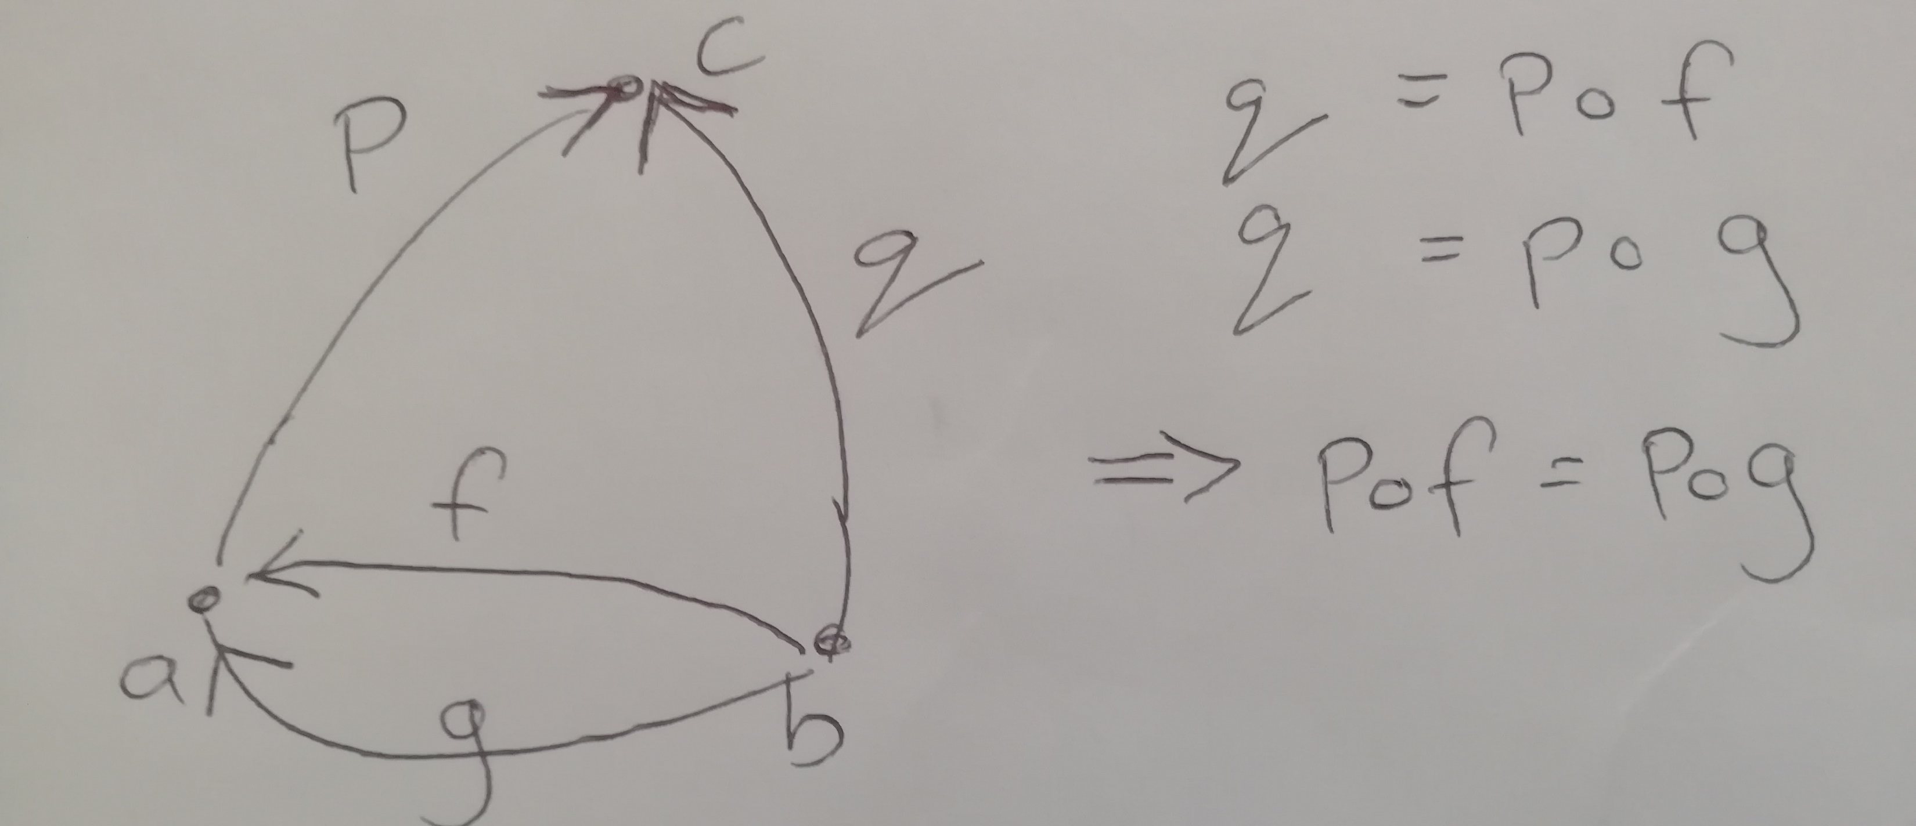
Exercises – Q4
The co-equaliser is the dual image of the equaliser in the opposite category. So it is the co-limit and not the limit.
This means that we have objects a, b and c with morphisms:
f: b to a, g: b to a, and morphisms p and q that go c from a and b, respectively.
Here, p.f = p.g
For any other c’, p’ there
exists a unique morphism
h from c to c’ such that
h o p = p’.

Slide 19
Exercises – Q5
Recall: when we pick a functor D from I to C we call the image a diagram.
Consider morphisms f:a->b, g: c->b
Pullback (towards b) is limit of the diagram generated by this category and as it is a universal construction it is unique up to isomorphism.
Now, assume b is the terminal object of the category. Then f and g are unique (by definition) for each a and c.
Since f and g are unique, the diagrams are in one-to-one correspondence with the pair (a, c). This is because there is no other morphism from a to b and c to b that could be chosen other than f and g in the diagram. So just defining a and c completely specifies the diagram.
Observe that (a,c) is the discrete category 2.
The product is the limit of a diagram generated by this discrete category (2).
Thus the pullback is a product.

Slide 20
Exercises – Q6
Exact same idea as 5) except using co-limits.

